Slide 1
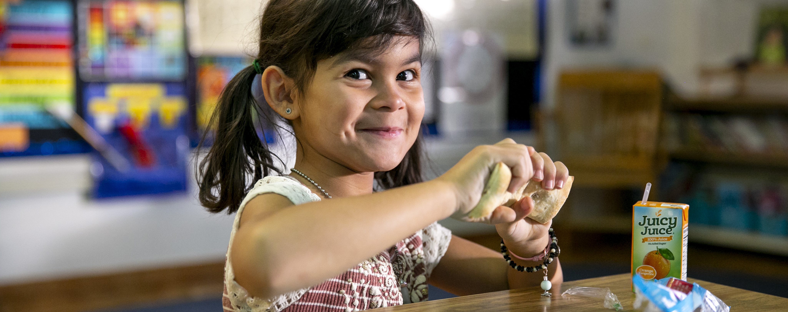
TALKING POINTS FOR Introducing breakfast after the bell TO SCHOOL STAKEHOLDERS
These talking points will help you get started as you plan to introduce school stakeholders—including teachers, principals, and superintendents— to Breakfast After the Bell. To use these talking points most effectively, personalize them by highlighting examples of successful Breakfast After the Bell programs happening at schools in your district or across your state.
ABOUT BREAKFAST AFTER THE BELL
Breakfast After the Bell, where breakfast is served after the official start of the school day, is one of the most effective ways to significantly boost school breakfast participation. Breakfast After the Bell shifts the time breakfast is served so that it’s a part of the school day, like lunch, and moves breakfast from the cafeteria to where students are, like classrooms and common areas. Learn more about the three models of Breakfast After the Bell in our Innovative Breakfast Delivery Options resource.
WHAT TO SAY TO ALL SCHOOL STAKEHOLDERS
Breakfast After the Bell reaches more students than traditional cafeteria breakfast. Fewer than half the kids who get a free or reduced-price school lunch, on average, get a free or reduced-price breakfast. Multiple barriers prevent students from accessing traditional cafeteria breakfast; Breakfast After the Bell addresses those barriers and enables more kids to start the day with a nutritious meal.
Kids who eat school breakfast are more likely to have a better overall diet. Students who participate daily in school breakfast are more likely to consume milk, whole grains, and fruit as part of their breakfast, compared to students who never or less frequently eat school breakfast.¹
Access to school breakfast is a racial equity issue. People of color deal with poverty and food insecurity at a much higher rate than white people. For example, Black people are two times more likely to experience poverty than the overall population of the United States.² Breakfast After the Bell ensures all students have the opportunity to start their day fueled up and ready to learn.

Slide 2
WHAT TO SAY TO TEACHERS
Eating breakfast in the classroom does not take away from instructional time. Breakfast takes on average 10-15 minutes, including cleanup. When breakfast is eaten in the classroom, many teachers use the time to take attendance, collect homework, or make announcements.
Breakfast cleanup can be quick and easy. Administrators, custodial staff, and teachers work together to create a cleanup plan that is best for your classroom and the school. The plan may include placing extra trash bins in hallways and in classrooms so that students can quickly and responsibly dispose of their trash. This teacher guide highlights best practices to create a plan for classroom setup and cleanup.
School breakfast is healthier than you may think. Any food items served at breakfast must meet dietary guidelines created by the United States Department of Agriculture (USDA). Menu items rotate to provide variety, but a school breakfast always includes milk, fruit, and whole grains Even though breakfast items provided to students at school sometimes look like the same breakfast items found in stores, school breakfast items often have more whole grains and less sugar, sodium, fat, and calories.
WHAT TO SAY TO PRINCIPALS
Breakfast After the Bell has the potential to decrease chronic absenteeism rates. Serving Breakfast After the Bell can reduce chronic student absenteeism by 6 percentage points on average, based on a 2019 study commissioned by Share Our Strength.
You can choose the Breakfast After the Bell model that best fits your school’s needs. The three Breakfast After the Bell models most effective at increasing participation in school breakfast are Breakfast in the Classroom, Grab and Go to the Classroom, and Second Chance Breakfast. Many schools operate a hybrid model that combines certain elements of these models. FRAC’s model guide can help you choose which model is right for your school.
WHAT TO SAY TO SUPERINTENDENTS
Breakfast After the Bell can increase participation and revenue. The more students that participate in school breakfast, the more federal reimbursement schools receive. Breakfast After the Bell is one of the most effective options for increasing student participation. Ensure all students get the nutrition they need and bring in more money– win, win!
Increased access to school breakfast can support improved academic achievement in subjects like reading.³ A national analysis found that, among young elementary school students, Breakfast in the Classroom (a Breakfast After the Bell model) was associated with a 1.5 percentage points statistically significant improvement in reading achievement.
¹ Au, L. E., Gurzo, K., Gosliner, W., Webb, K. L., Crawford, P. B., & Ritchie, L. D. (2018). Eating School Meals Daily Is Associated with Healthier Dietary Intakes: The Healthy Communities Study. Journal of the Academy of Nutrition and Dietetics, 118(8), 1474-1481.e1. https://doi.org/10.1016/j.jand.2018.01.010
² Move for Hunger, Hunger is a Racial Equity Issue. Available here.
³ Gottfried, M. A., & Kirksey, J. J. (2020). Research Brief: Evaluating the Impact of Breakfast After the Bell on Chronic Absenteeism. https://bestpractices.nokidhungry.org/sites/default/files/media/ChronicAbsenteeism_ResearchBrief_2.pdf

