Slide 1
Menu Ideas to Boost Afterschool Meals Participation
November 13, 2018
3:00 PM ET

Slide 2
Housekeeping
Listen-only mode
Submit questions and ideas in the “Questions” section of the GoToWebinar menu
Questions will be addressed at the end
Respond to poll questions throughout
Recording and resources available afterward

Slide 3
Introductions
Carolyn Wait Senior Program Manager, Center for Best Practices No Kid Hungry campaign

Slide 4
No Kid Hungry’s work on afterschool meals has been made possible through the generous support of Tyson Foods, Inc.

Slide 5
Agenda
Background on No Kid Hungry’s Afterschool Work
Panelist Introduction
Overview of Panelists’ Afterschool Programs
Moderated Q&A
Audience Q&A
Resources to Support Your Work
Notes:
Not spending long on what the program is or how it works, but we have prior webinars and other materials that cover that information, and I’ll tell you how to find that at the end.

Slide 6
No Kid Hungry is ending childhood hunger through effective programs that provide kids with the food they need.
No Kid Hungry is a campaign of Share Our Strength, an organization working to end hunger and poverty in the US and abroad.

Slide 7
No Kid Hungry’s Center for Best Practices provides information, tools, and resources designed to end childhood hunger.
Notes:
We offer technical assistance and develop case studies, reports, webinars, trainings and more to support organizations that operate child nutrition programs and help educators, community leaders, elected officials and policy makers working to end childhood hunger.

Slide 8
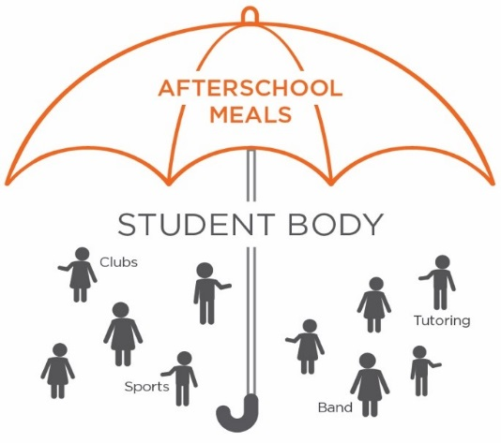
Supper in the
Classroom
Umbrella Model
Timing and Logistics
Transportation
Effective Promotion
Packaging and Branding
Partnerships

Slide 9
Why Address Menus?
Meet meal pattern requirements
Excite kids about meals
Align with sponsor + site capacity
Notes:
-- Meal pattern requirements have been in effect for a little over a year, and the transition year recently ended – good time to share ideas on what’s working and where challenges still lie
-- While it’s important to introduce kids to new foods and help them develop an appreciation for healthy options, you also need to attract kids to your sites and get them to want to eat in the first place.
-- And you have to do all of this within the limits of sponsor, vendor, and district capacity. Just because you may not be able to afford a walk-in fridge and hot serving line at each site doesn’t mean that those kids shouldn’t have access to a meal.

Slide 10
Poll Question

Slide 11
Panelists
Shannon Amos, Senior Director of Agency Programs, Children’s Hunger Alliance (OH)
Sara Eugene, Program Development and Compliance Coordinator, Minneapolis Public Schools Culinary and Wellness Services (MN)
Anne Ferreira, Menu Planner, Minneapolis Public Schools Culinary and Wellness Services (MN)

Slide 12
MENU IDEAS TO BOOST AFTERSCHOOL MEALS PARTICIPATION
Shannon Amos
Senior Director, Agency Programs

Slide 13
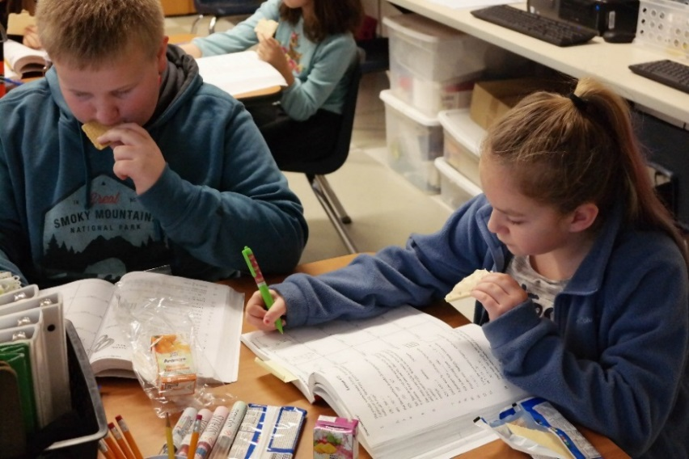
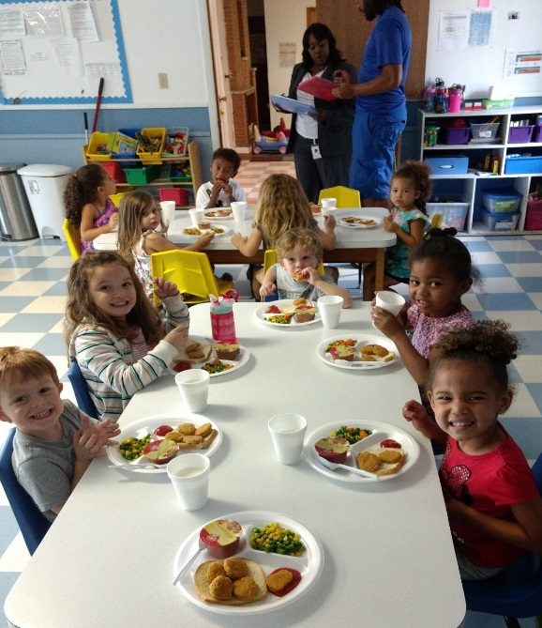
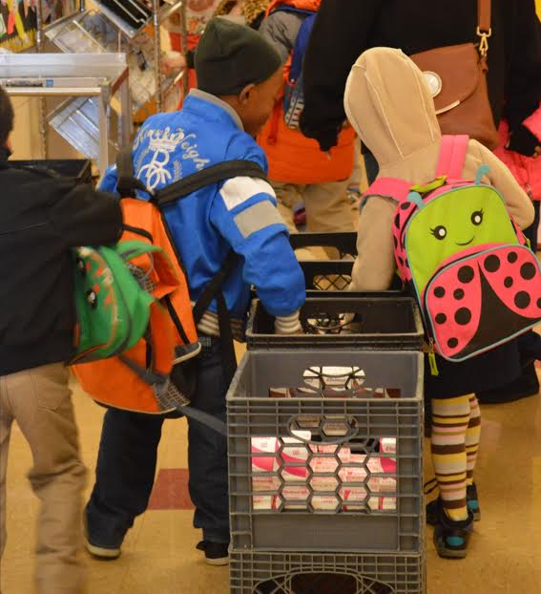
Overview
About Children’s Hunger Alliance
How We Address Hunger
Afterschool At-Risk
Shelf-Stable Pilot Projects
Notes:
Ask the audience– afterschool & summer sponsors? Who else in the room?
Ask a few people say why they were interested in this session

Slide 14
Children’s Hunger Alliance
A statewide non-profit organization dedicated to ending childhood hunger in Ohio
Our mission is to purposefully ensure that children without access receive healthy food, nutrition education and physical activity.
One of the largest CACFP Sponsors in the state of Ohio, sponsoring homes, centers and afterschool at-risk
Ohio ranks 18th in the nation for food insecurity; approximately 1 in 5 or 529,000 children live in food insecure households
Notes:
Children’s Hunger Alliance is a statewide nonprofit organization dedicated to ensuring that children without access receive healthy food, nutrition education, and physical education.

Slide 15
How We Address Childhood Hunger
Provide Meals through USDA CACFP Sponsorship
Afterschool at-risk programs (275+); Family child care providers (~800) and Daycare Centers (25+)
Helped to provide 7.1 million meals and snacks in 2017
Increase Access to School Breakfast Programs & Summer Meal Programs
We advocate and consult with programs to increase and expand access to these critical meals.
Educate and engage children and caretakers in nutrition and physical education
Reach children through afterschool & summer programs and daycare centers
Provide nutrition education training to childcare providers
Notes:
We help provide nutritious meals and snacks to afterschool programs such as Boy & Girls Clubs, rec centers, schools and churches, libraries, etc.
We help childcare providers and daycare centers serve more nutritious meals and snacks to the children in their care and promote healthy eating habits and activities.
We work with school districts to begin or expand school breakfast programs so that more children can start the day with a good meal. School breakfast increases concentration, standardized test scores and attendance while decreasing tardiness and trips to the nurses office.
We work with summer meal sites like community centers and day camps to provide healthy food and fun physical activities when school is out for the summer. Summer meals help increase attendance at enrichment programs that reduce summer learning loss.
We also help educate children and caretakers about nutrition and physical activity. We offer nutrition education for school-aged children and have also recently launched a program called EatPlayGrow for preschoolers.

Slide 16
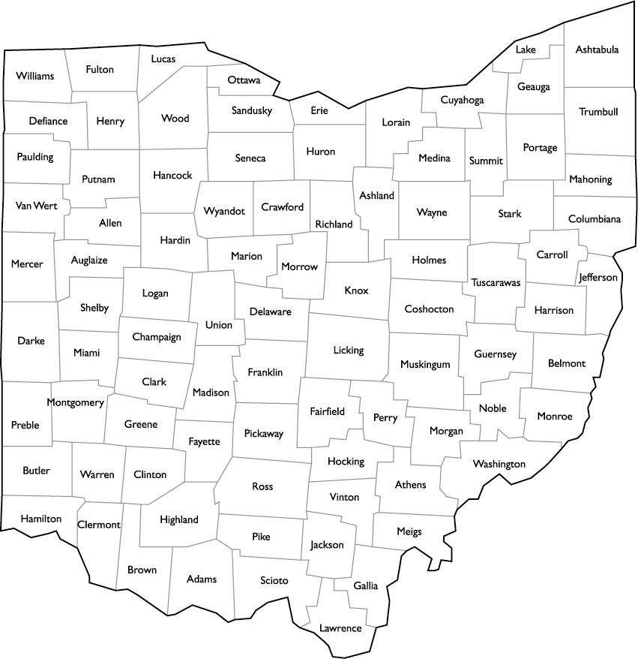
Afterschool At-Risk Sponsorship
Sites
Sponsor for 20+ years
Prior to creation of Afterschool At-Risk operated as an Out-of-School-Time sponsor for afterschool programs
275+ afterschool sites sponsored
Primarily urban afterschool settings, though starting to expand into rural areas
Sponsor all unaffiliated sites
Recreation centers, libraries, charter & public schools, churches, YMCA/YWCA’s, community-based organizations
Stats
942,000 meals and snacks provided in FY18

Slide 17
Afterschool At-Risk Sponsorship
Food Service
All public bid and small purchase agreements
7 vendor contracts with 6 vendors
Unitized & delivered hot/cold; mostly daily
Predominantly hot, cold, snack menus offered
Shelf-stable used for back-up on site (or in a few cases as part of regular menu offerings)
Menus
Standard menus exceed USDA requirements:
More fresh produce
Limited breaded/processed protein items
Variety standards

Slide 18
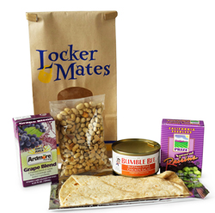
Shelf-Stable Pilot Projects
Back-Up:
Attendance fluctuations, when more children were in attendance than anticipated (ADP used for daily order)
Scheduled food delivery could not be made on inclement weather days or site made last minute decision to remain open
An unexpected delivery issue prevents the standard food order from being delivered
Program Expansion (Rural/Lacking Vendor):
Provide full shelf-stable meal/snack menu until more permanent solution found

Slide 19
Questions?
Shannon Amos
Senior Director, Agency Programs
samos@childrenshungeralliance.org
Also, like us, share our posts, pin our photos, watch our videos and more!
Twitter.com/CHAOhio
Facebook.com/childrenshungeralliance
YouTube.com/CHAOhio
LinkedIn.com/company/children's-hunger-alliance

Slide 20
Minneapolis Public Schools
Culinary and Wellness Services
Anne Ferreira
Anne.Ferreira@mpls.k12.mn.us
Menu Planner
Sara Eugene
Sara.Eugene@mpls.k12.mn.us
Program Development and Compliance

Slide 21
MPS CWS: By the Numbers
36,531 students
59% eligible for free or reduced price meals
68% identify as students of color
~ 56,000 meals & snacks served daily
14,000 breakfasts
115 sites
22,000 lunches
11,500 fresh fruit and vegetable snacks
5,000 after-school snacks
3,500 suppers
70 school kitchen sites
45 community after-school sites
38% African American
18% Hispanic or Latino
6% Asian American
4% Native American
1 central kitchen
Notes:
Sara

Slide 22
MPS CWS: After-School Menu Options
Supper: Cold Meals
No minimum student count
Snack
After-School program staff at point of service
Picnic dinner OR SuperSnack option
No minimum student count
After-School program staff trained for point of service
Schools: Three week cycle, refrigeration required
Two week cycle
Refrigeration required
Community sites: Two week cycle, shelf-stable
Supper: Hot Meals
100 minimum student count
Served via cafeteria by MPS CWS employee
After-School program staff at point of service
Five component
Offer vs Serve
Notes:
Sara

Slide 23
Notes:
Kate

Slide 24
Notes:
Kate

Slide 25
Poll Question

Slide 26
Poll Question

Slide 27
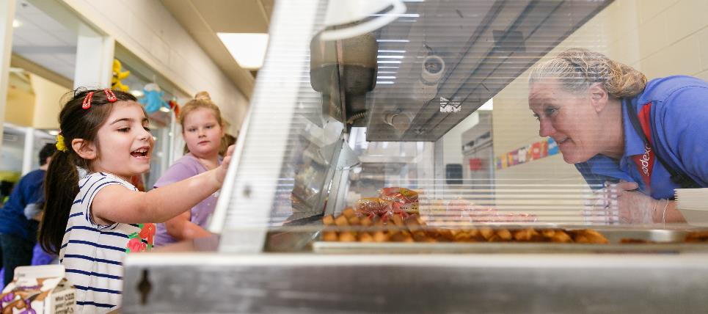
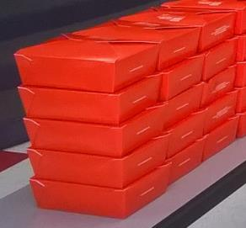
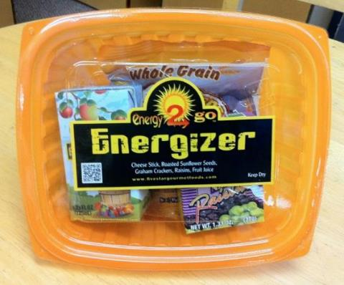
Panel Q&A

Slide 28
Poll Question

Slide 29
Panel Q&A

Slide 30
Poll Question

Slide 31
Panel Q&A

Slide 32
Audience Q&A

Slide 33
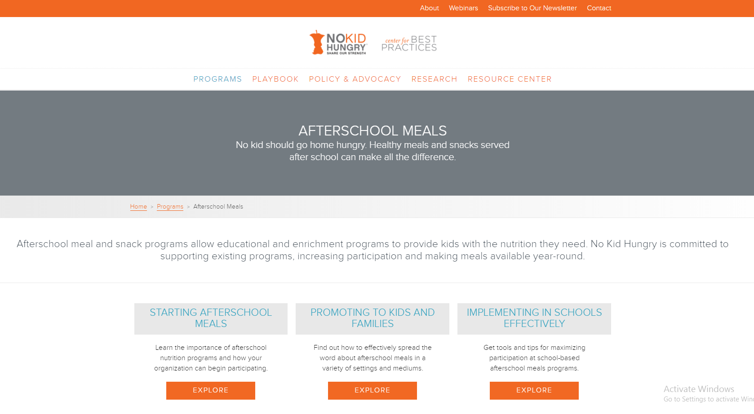
Resources at bestpractices.nokidhungry.org

Slide 34
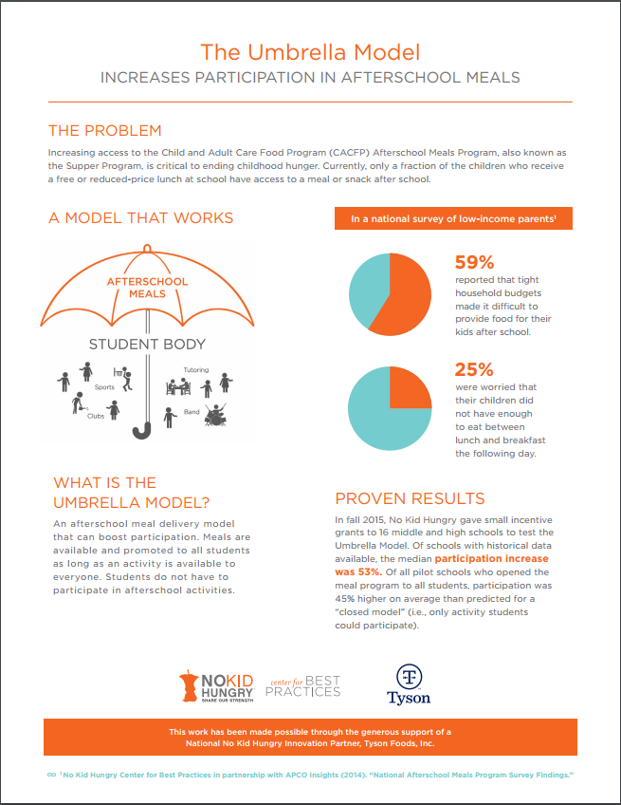
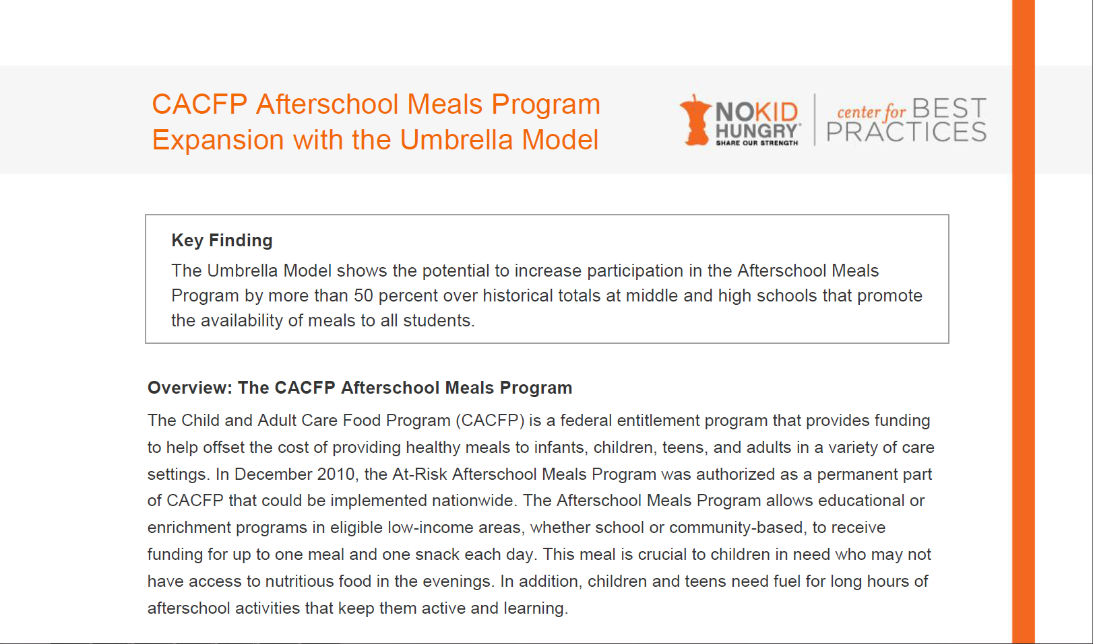
Umbrella Model
https://bestpractices.nokidhungry.org/programs/ afterschool-meals/implementing-in-schools-effectively

Slide 35
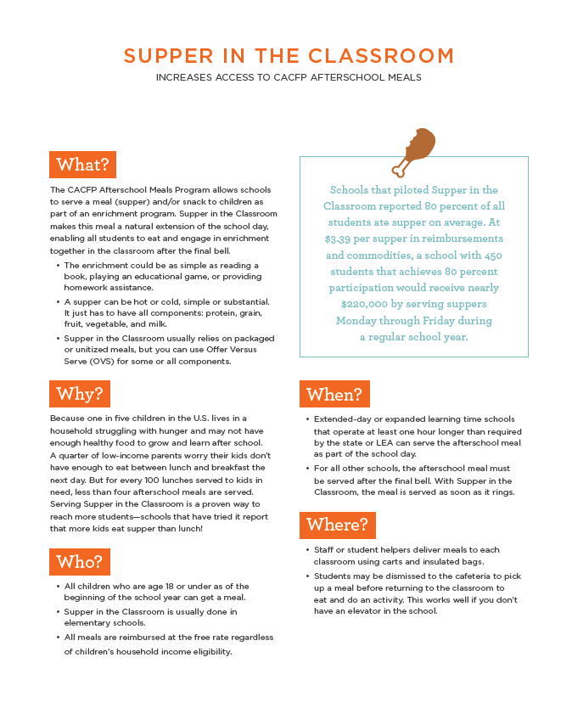
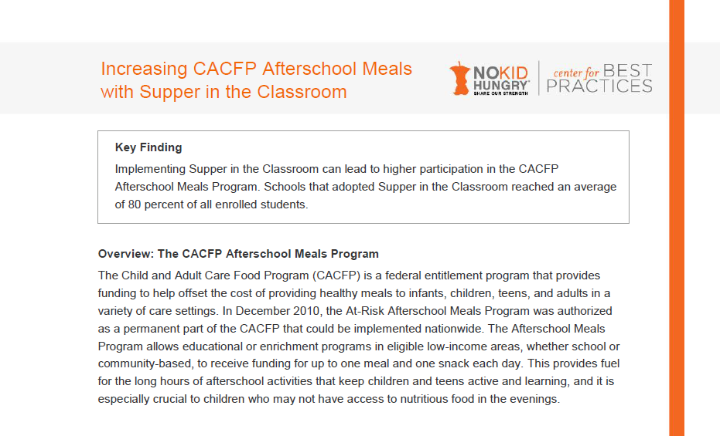
Supper in the Classroom
https://bestpractices.nokidhungry.org/programs/ afterschool-meals/implementing-in-schools-effectively

Slide 36
Webinar Recordings
Afterschool Meals: A Win-Win-Win for Schools
https://bestpractices.nokidhungry.org/webinars/afterschool-meals-win-win-win-schools
Start the School Year Right with Innovative Approaches to Afterschool Meals
https://bestpractices.nokidhungry.org/webinars/start-school-year-right-innovative-approaches-afterschool-meals
Go Where the Kids Are: Find Success with Supper this School Year
https://bestpractices.nokidhungry.org/webinars/go-where-kids-are-find-success-supper-school-year

Slide 37
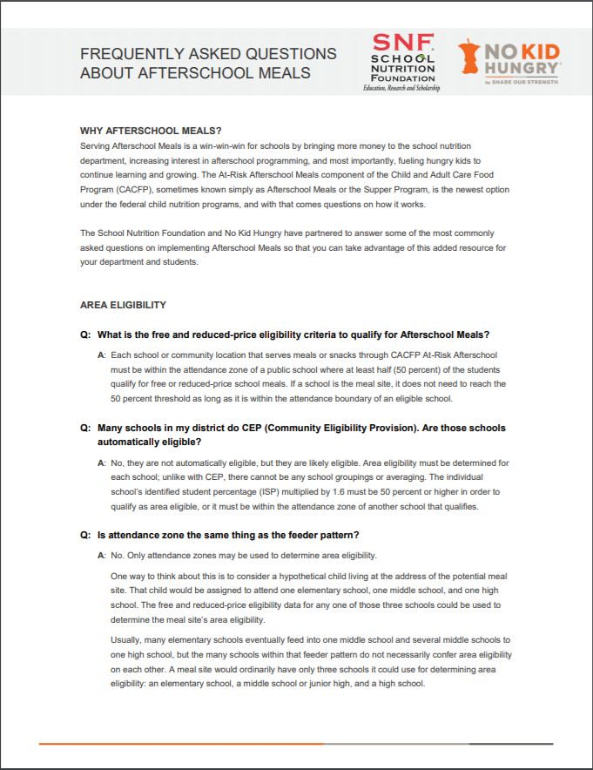
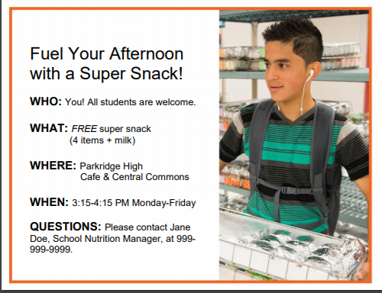
Additional Resources

Slide 38
More Resources
Alliance for a Healthier Generation
Smart Food Planner: https://foodplanner.healthiergeneration.org/
Amazon Store: https://www.amazon.com/b/?&node=13951371011&suppress-ve=1&ref_=b2b_ahg_w
USDA
Team Nutrition “Thirty on Thursday” webinar series: https://www.fns.usda.gov/cacfp-halftime-thirty-thursdays-training-webinar-series
Team Nutrition Training Tools: https://www.fns.usda.gov/cacfp-training-tools

Slide 39
Thank you!
Carolyn Wait
Senior Program Manager, Center for Best Practices
No Kid Hungry campaign
cwait@strength.org
202-599-4401
www.bestpractices.nokidhungry.org

